Slide 1
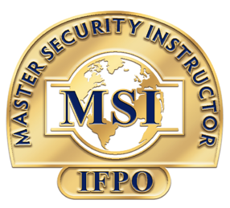
Contact Us For Agreement
+65 156 7661 9872
JOIN THE TOP TIER OF
MASTER SECURITY INSTRUCTORS (MSI)
Introduction Webinar
17th October 2024
International Foundation for Protection Officers (IFPO)

Slide 2
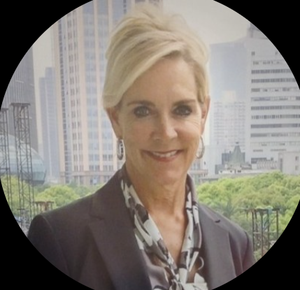
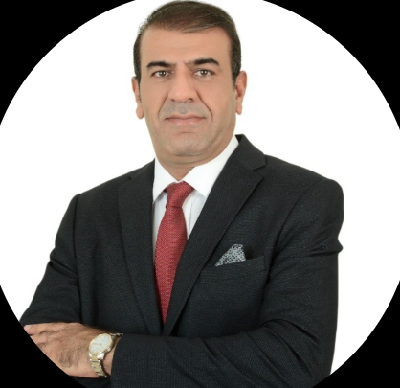
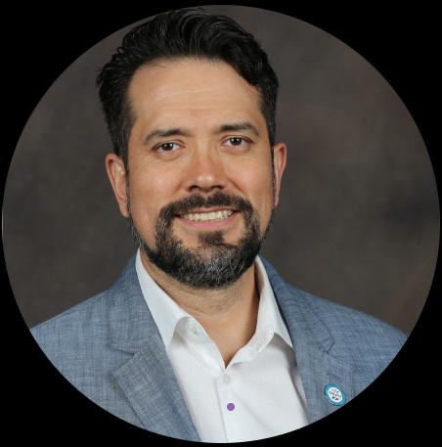
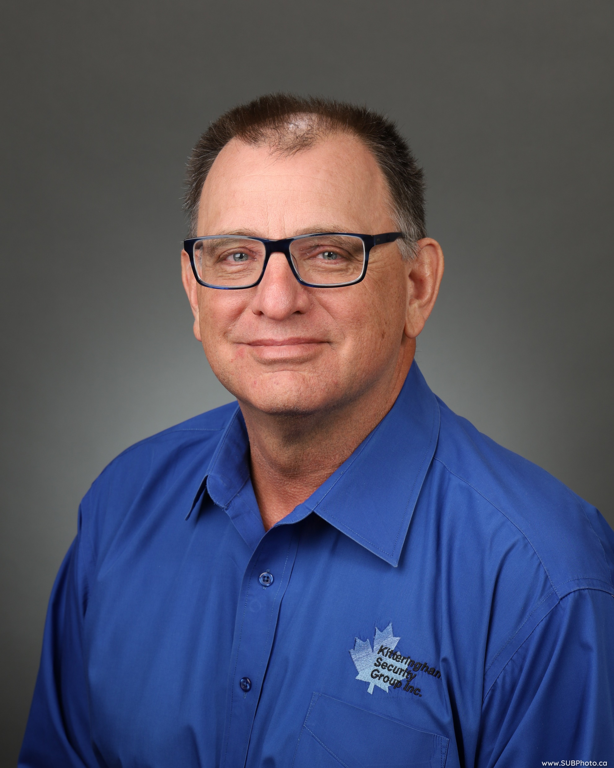
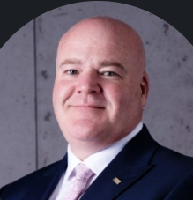
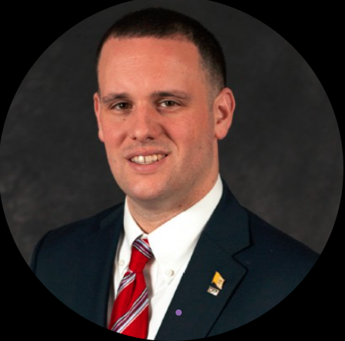
Contact Us For Agreement
+65 156 7661 9872
Introduction To Our Team
Sandi Davies
Nadeem Iqbal
Kevin Palacios
Chief Executive Officer
IFPO
Director MENASA & Global Advisory Board Member
Director LATAM & Global
Board Member
Dr. Glen Kitteringham
Garry Bergin
Matthew Porcelli
Research Criminologist & Security Consultant
IFPO Ireland
Advisory Board Member
IFPO Ethics
Committee Member

Slide 3
Contact Us For Agreement
+65 156 7661 9872
Career Development Pathways
Typical Security Professional Development Pathway
Start the career a practitioner then excel into Specialization in a field of interest or take the Instructional role / Consultation etc
Security Operations Center
CCTV & Access Control Systems
Technology & Artificial Intelligence
Investigations / Audits
Specialization
1
Certified Protection Officer Instructor (CPOI)
Master Security Instructor (MSI)
Instructional
2
Initial Security Officer Program
Professional Security Officer Program
Certified Protection Officer Program
Certified in Security Supervision Management

Slide 4
Contact Us For Agreement
+65 156 7661 9872
CPOI Certification
CPOI Benefits
Certified Protection Officer Instructor (CPOI) Certification
CPOIs can promote their services as IFPO-endorsed instructors
Training
Supplementation
CPOIs continue to learn more through research, study and exchange of ideas and learner interactions
Scope
Recognition
Officially endorsed by IFPO and listed on our website.
CPOIs are authorized to instruct IFPO programs
Transition
Transitioning to private specialist roles, expanding their knowledge for training delivery
Continual Improvement
IFPO Instituted A Professional Development Path For Security Instructors

Slide 5
Contact Us For Agreement
+65 156 7661 9872
MSI Certification
MSI Benefits
Master Security Instructor
(MSI) Certification
Education & Training Qualifications
Formal Teaching Credentials, Specialized Knowledge
Peer Evaluation
Recommendations, Document Assesment Review
Scope
Security Qualifications
Educational Degrees’, Professional Certifications’ Validation
MSIs are validated to instruct beyond IFPO programs.
Continuous Professional Development
Ongoing Education, Contributions to the Field.
Continual Improvement
IFPO Instituted A Professional Development Path For Security Instructors

Slide 6
Contact Us For Agreement
+65 156 7661 9872
Difference Between CPOI & MSI Certification
Certified Protection Officer Instructor (CPOI) Certification
Master Security Instructor
(MSI) Certification
Scope
Scope
CPOIs are authorized to instruct IFPO programs
MSIs are validated to instruct beyond IFPO programs.
Continual Improvement
IFPO Instituted A Professional Development Path For Security Instructors

Slide 7
Contact Us For Agreement
+65 156 7661 9872
CPOI Application Process
Applicants for the CPOI must meet the following prerequisites to apply:
1
2
3
At least five (5) years of specific experience in teaching, in the role of an instructor
or equivalent
At least three (3) years of experience in comprehensive protection work.
Post Secondary degree, certification or specialized training from a college/university
or technical institution
4
5
6
Current Certified Protection Officer (CPO) Certification.
Member of the IFPO
Completion of comprehensive CPOI application

Slide 8
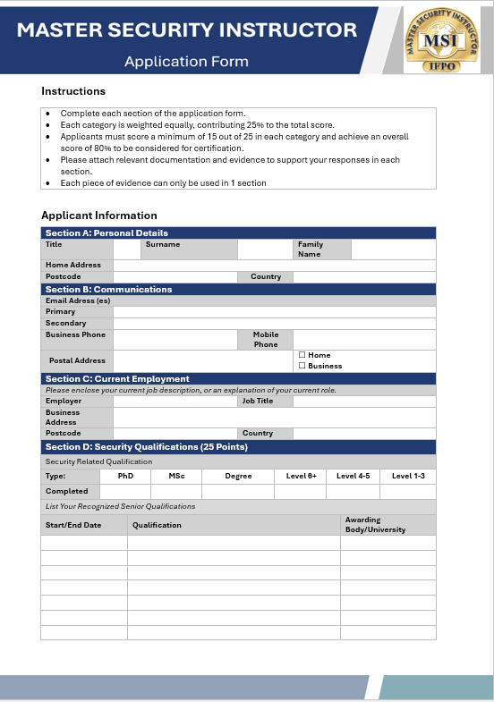
Contact Us For Agreement
+65 156 7661 9872
MSI Application Process
To Become An MSI, Applicants Will Enter A Peer Review Process:
1
2
3
Document Assessment (completed by two Assessors).
Professional Interview (completed by two Assessors).
Recommendation for admittance/ review to MSI Registrars.
4
5
Recommendation to IFPO Global Advisory Members.
Admittance of application as MSI.

Slide 9
Contact Us For Agreement
+65 156 7661 9872
QUESTIONS & ANSWERS
Want to know more ; reach us at:
info@ifpo.org
Submit your interest
before 30th November 2024
to avail 20% discount
MSI2024#2

