Slide 1
International Foundation For Protection Officers (IFPO)
International Organization of Black Security Executive
(IOBSE)

Slide 2
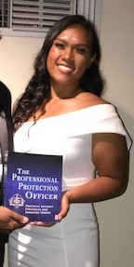
Alelee Figueroa
Alelee Figueroa is awarded the IFPO Initial Security Officer Program Course. This course provides online training to help improve the knowledge and performance of private security officers part of an initial training program. The training is designed to assist security agencies, and officers, to meet many of the published private security officer training guideline recommendations.
This course will jump start Ms. Figueroa’s understanding of this element of the Security Industry. He also was provided a copy of the 8th edition of The Professional Protection Officer Manual. The Manual is used by over200 Colleges and Universities world wide.
The International Foundation for Protection Officers is a non-profit organization headquartered in Naples, Florida, United States. The organization was established in January 1988 to help address the training and certification needs of security protection officers and their supervisors internationally.

Slide 3
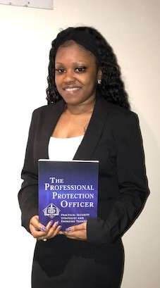
Domonique Austin
Domonique Austin is awarded the IFPO Initial Security Officer Program Course. This course provides online training to help improve the knowledge and performance of private security officers part of an initial training program. The training is designed to assist security agencies, and officers, to meet many of the published private security officer training guideline recommendations.
This course will jump start Ms. Austin’s understanding of this element of the Security Industry. He also was provided a copy of the 8th edition of The Professional Protection Officer Manual. The Manual is used by over200 Colleges and Universities world wide.
The International Foundation for Protection Officers is a non-profit organization headquartered in Naples, Florida, United States. The organization was established in January 1988 to help address the training and certification needs of security protection officers and their supervisors internationally.

Slide 4
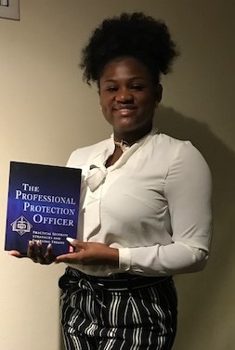
Latisha Floyd
Latisha Floyd is awarded the IFPO Initial Security Officer Program Course. This course provides online training to help improve the knowledge and performance of private security officers part of an initial training program. The training is designed to assist security agencies, and officers, to meet many of the published private security officer training guideline recommendations.
This course will jump start Ms. Floyd’s understanding of this element of the Security Industry. He also was provided a copy of the 8th edition of The Professional Protection Officer Manual. The Manual is used by over200 Colleges and Universities world wide.
The International Foundation for Protection Officers is a non-profit organization headquartered in Naples, Florida, United States. The organization was established in January 1988 to help address the training and certification needs of security protection officers and their supervisors internationally.

